Slide 1
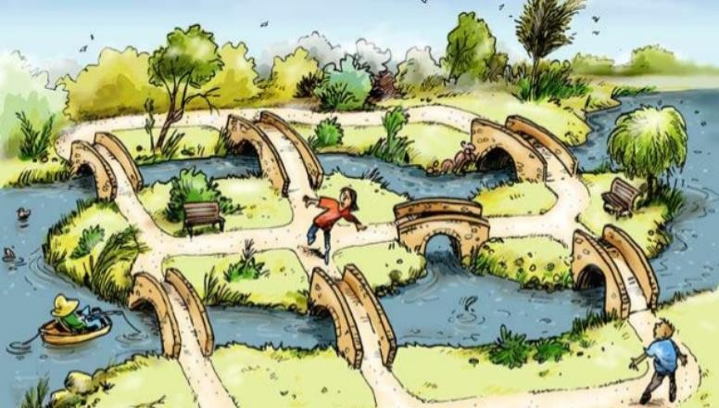
Konigsberg Bridges Problem

Slide 2
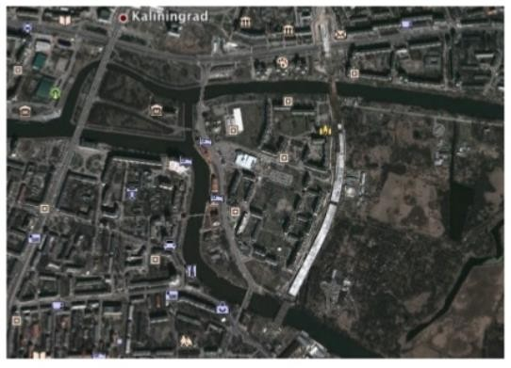
The city now is called Kaliningrad (former German name: Königsberg)
Can you see the seven bridges?

Slide 3
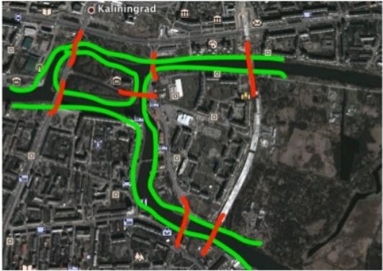
The city now is called Kaliningrad (former German name: Königsberg)
Can you see the seven bridges? Now?

Slide 4
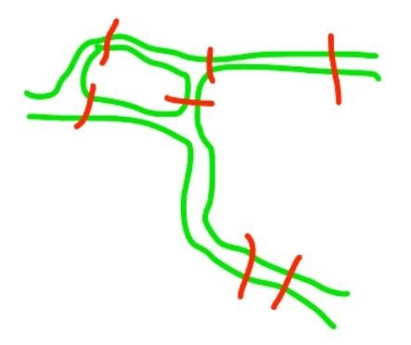
The Seven Bridges of Konigsberg
A crude map of the center of Konigsberg might look like this:
The people wondered whether or not one could walk around the city in a way that would involve crossing each bridge exactly once

Slide 5

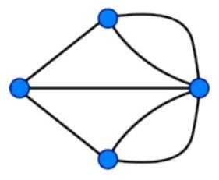


Euler realized that all problems of this form could be represented by replacing areas of land by points (he called them vertices), and the bridges to and from them by arcs. For Konigsberg, let us represent land with Blue dots and bridges with black curves:
Real World Map ==========➔ Mathematical Abstraction

Slide 6
The problem now becomes one of drawing this picture without retracing any line and without picking your pencil up off the paper.

Slide 7
Euler generalized this mode of thinking by making the following definitions and proving a theorem:
Definition: A network is a figure made up of points (vertices) connected by non-intersecting curves (arcs).
Definition: A vertex is called odd if it has an odd number of arcs leading to it, other wise it is called even.
Definition: An Euler path is a continuous path that passes through every arc once and only once.
Euler’s work on this problem has given birth to “Graph Theory”

Slide 8
So, Can you find a solution for Konigsberg bridges problem?
No, and no one can either!
Thus, there is no algorithm for this problem! (NP-hard)
Real World Map ==========➔ Mathematical Abstraction

Slide 9
WHAT ARE GRAPHS?

Slide 10
Graph
1
4
vertex
2
edge
3
In a graph, we have some vertices and edges. An edge links two vertices together, with or without a direction.
Notes:
10

Slide 11
Graph
Mathematically, a graph is defined as G=(V,E),
V is the set of vertices (singular: vertex)
E is the set of edges that connect some of the vertices
For convenience,
Label vertices with 1, 2, 3, …
Edges can be represented by their two endpoints.

Slide 12
Graph
Directed/Undirected Graph
Weighted/Unweighted Graph
Simple Graph
Connectivity

Slide 13
Graph Modelling
S
 |  |  |  | E
S
E

Slide 14
GRAPH REPRESENTATION

Slide 15
Representation of Graph
How do we store a graph in a program?
Adjacency Matrix
Adjacency linked list
Edge list
Notes:
15

Slide 16
Adjacency Matrix
 | 1 | 2 | 3 | 4 | 5 | 6
1 | 0 | 0 | 1 | 0 | 1 | 1
2 | 0 | 0 | 0 | 0 | 0 | 0
3 | 1 | 0 | 0 | 0 | 0 | 1
4 | 0 | 0 | 0 | 0 | 0 | 0
5 | 0 | 1 | 0 | 0 | 0 | 0
6 | 0 | 0 | 0 | 1 | 0 | 0
1
5
6
2
3
4

Slide 17
Adjacency Linked List
1 | → | 3 | → | 5 | → | 6
2
3 | → | 1 | → | 6
4
5 | → | 2
6 | → | 4
1
5
6
2
3
4
Notes:
17

